Slide 1
Unfold your UI
Building awesome foldable apps with .NET and Avalonia
Javier Suárez
Software Engineer, Avalonia UI · @jsuarezruiz
Notes:
0:00 to 0:30. Let the cover sit for a few seconds. Say the talk in one sentence: foldables are here, and everything today comes down to one idea, know where the fold is and design around it, from one .NET codebase with Avalonia.

Slide 2

Javier Suárez
Before Avalonia
Worked on Xamarin.Forms and .NET MAUI at Microsoft
Community
Former Microsoft MVP, speaker, and one of the people behind SevillaDotNet
About me
OSS
Avalonia: Nova.Avalonia.UI, Cupertino.Avalonia, Vignettes
.NET MAUI: awesome-dotnet-maui (2.7k stars), AlohaKit
Xamarin.Forms: goodlooking-UI (2.5k stars), Xamanimation
Software Engineer at Avalonia UI, building cross-platform UI.
Find me
@jsuarezruiz on GitHub, X, Mastodon and YouTube
Notes:
0:30 to 1:00. Keep it short. I’m Javier, a software engineer at Avalonia UI, where I build cross-platform UI. Before that I worked on Xamarin.Forms and .NET MAUI at Microsoft, so I have been thinking about one codebase on many screens for a long time. I’m a former Microsoft MVP and I help run the SevillaDotNet community. If you have ever looked for good-looking Xamarin.Forms samples, there is a chance you have seen my repos; this talk continues that tradition with foldables. I’m @jsuarezruiz everywhere. (Facts from the public GitHub profile, October 2026; star counts change, update before the talk.)

Slide 3
Foldables aren’t new
Why now
2018
2019
2020
2022
2023
2026
Royole FlexPai
Galaxy Fold
Surface Duo
Android 12L
Pixel Fold
iPhone Duo
The first foldable phone on sale.
Samsung takes book foldables mainstream.
Microsoft’s two screens and a hinge, with TwoPaneView.
Android designs for large screens and folds.
Google’s own book foldable.
Apple’s first foldable.
Notes:
1:00 to 1:30. Foldables aren’t new. The first one went on sale in 2018, Samsung made book foldables mainstream in 2019, and in 2020 Microsoft shipped the Surface Duo, two screens and a hinge on Android, with TwoPaneView for Xamarin.Forms. Android has designed for large screens and folds since 12L, and Google makes its own Pixel Fold. The one platform still missing was the iPhone.

Slide 4
The iPhone folds.
Friday, October 23, 2026
iPhone Duo: a 7.6″ inner display, a 5.4″ outer display, and a hinge built from more than 100 components. From $1,999.
“The most transformational change to iPhone since the original.”
John Ternus, Apple
Source: Apple Newsroom, “Apple unveils iPhone Duo”, September 2026
Notes:
1:30 to 2:10. Then came the news everybody saw. On October 23 Apple shipped its first foldable. By the time you watch this, it has been in people’s hands for about three weeks. Two displays: a 5.4 inch outer display, about 90% of an iPhone 18 Pro’s screen area, and a 7.6 inch inner display, 50% bigger than the Pro Max. Same aspect ratio on both. Apple’s own CEO calls it the biggest change to the iPhone since 2007. For us as developers, that means a lot of assumptions baked into iPhone apps since 2007 just stopped being true.

Slide 5
Small market, big spenders, and now Apple
Why now
18.2M
20M+
580M+
foldable phones shipped worldwide in 2025
forecast to ship in 2026, iPhone Duo included
large-screen Android devices in use
Omdia, Aug 2026
TrendForce 20.2M, Omdia 22M+
Google, May 2026
25%
40%
up to 14×
Apple’s 2026 share, about 5M iPhone Duos
Apple’s expected share of all foldables in 2027
how much more foldable users can spend than phone-only users
TrendForce forecast, Sep 2026
IDC and Counterpoint forecasts
Google internal data, 2026
Notes:
2:10 to 3:30. Six numbers, top row the market, bottom row the opportunity. 18.2 million foldables shipped in 2025, up 6% on 2024 (Omdia). For 2026 the forecasts land between 20.2 million (TrendForce) and more than 22 million (Omdia), both with the iPhone Duo included. Google counts more than 580 million large-screen Android devices in people’s hands: tablets, foldables, Chromebooks. Bottom row, the lavender ones are Apple: TrendForce expects about 5 million iPhone Duos in 2026, roughly a quarter of the market, tied with Huawei and behind Samsung’s 7.1 million, even though Apple only shipped in late October. IDC expects more than 10 million in the Duo’s first year, and both IDC and Counterpoint expect Apple to be about 40% of all foldables in 2027. And the one for your product manager: Google reports multi-device users spend 9x more than phone-only users, and on foldables that multiplier can reach 14x. Foldables are still around 2% of all smartphones, so this is about who the users are, not volume. The forecasts disagree on market growth (IDC +12.6% in 2026, TrendForce +0.5%, Omdia +22%), so I only quote shares. Sources: Omdia via TelecomLead, Aug 21 2026; TrendForce, Sep 10 2026; IDC via 9to5Mac, Aug 26 2026; Counterpoint, Sep 2026; Android Developers Blog, May 19 2026.

Slide 6
The platforms stopped asking
Why now
Android 17 · API 37
iPhone Duo · iOS 27.1 SDK
Orientation locks are ignored on large screens
Edge to edge on the inner display
Apps built with the iOS 27.1 SDK fill the inner display, bars move to the side, and supported orientations are ignored there.
On displays 600dp wide and up, the system ignores screenOrientation, resizeableActivity and aspect-ratio limits. Android 16 let you opt out. Android 17 doesn’t.
“On iPhone Duo, the device’s orientation doesn’t tell you what shape your app is.” Apple, Preparing your app for iPhone Duo
Notes:
3:30 to 4:30. Both platforms made adaptive layouts non-optional this year. Android 16 started ignoring orientation, resizability and aspect-ratio restrictions on large screens (smallest width 600dp and up) for apps targeting API 36, with a temporary opt-out. Android 17, API 37, removes the opt-out, and Google Play requires new target levels on a yearly schedule. On iOS, apps built with older SDKs run in a centered, familiar-size box on the Duo’s inner display. Built with iOS 27.1, they go edge to edge, the bars move vertically to the side, and the inner display ignores your supported orientations. So the question is no longer whether to adapt. It is how well. Sources: Android Developers Blog, Jan 2025 and May 2026; developer.apple.com/iphone-duo/prepare.

Slide 7

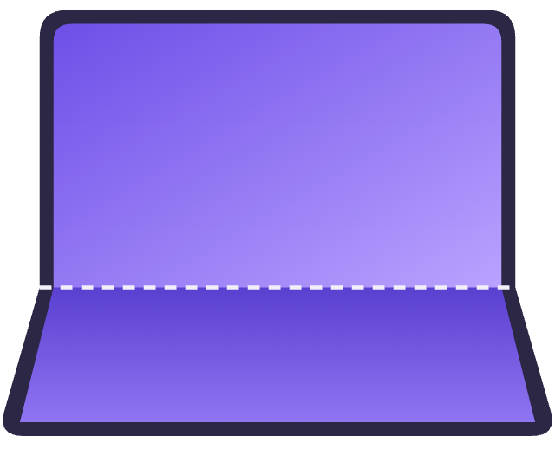
Four postures to design for
Part 1 of 4 · Core concepts
Book foldables (iPhone Duo, Galaxy Z Fold, Pixel Fold) and flips (Galaxy Z Flip, razr) share them, and your app moves between displays while it runs.
Closed
Flat
Book
Tabletop
Closed
Flat
HalfOpened + Vertical
HalfOpened + Horizontal
The cover display. Usually one pane.
Fully open. The fold is there, but it divides nothing.
Held like a book. Two pages, left and right.
Standing on a table. Content above, controls below.
Notes:
4:30 to 6:00. First, the hardware comes in two families. Book style: a phone-sized cover display and a tablet-sized inner display, like the iPhone Duo, the Galaxy Z Fold and the Pixel Fold. Flip style: a small cover screen and a regular phone inside that folds horizontally, like the Galaxy Z Flip and the Motorola razr; a flip’s inner display is under 600dp wide, so Android’s large-screen rules don’t apply to it, but folding still resizes your app. Either way, the user folds while your app is open, so it is resized in the middle of a session. Then four postures cover almost everything. Closed: you are on the cover display, a phone, usually one pane. Flat: fully open, the fold exists but doesn’t divide anything, so you can span content across it. Book: half open with a vertical fold, like holding a book; two pages, left and right. Tabletop: half open with a horizontal fold, standing on a table like a tiny laptop; content on the top half, controls on the bottom half where your thumbs are. The purple labels are what the library reports: Posture is Closed, Flat or HalfOpened, or Unknown when the platform can’t tell, as on an Android cover display without a hinge sensor, and the fold orientation tells book from tabletop. Apple’s overview shows six poses for the Duo, including tent and laptop, but in code they reduce to these.

Slide 8
The fold is just a rectangle
Core concepts
FoldBounds
40pt
Where the fold is, in window coordinates. Nothing tappable goes there.
IsSeparating
Does it divide the content right now? True when half open.
Pane 1
Pane 2
Orientation
Vertical: panes left and right. Horizontal: panes above and below.
iPhone Duo inner display: 951 × 669pt, fold at x = 455.5
Notes:
6:00 to 7:00. This is the most important idea of the talk. You don’t need to model hinges or physics. The fold is a rectangle in your window, and three facts about it decide your layout. Where it is. Whether it currently divides the content: on Android, HALF_OPENED always reports isSeparating true; on the Duo the division region is active when partially open and inactive when fully open. And which way it runs. The numbers here are real: on iOS 27.1 the iPhone Duo reports its fold as a 40-point band at x 455.5 on the 951 by 669 inner display. Keep both panes out of that band and keep every touch target out of it.

Slide 9
One idea, three APIs
Core concepts
Concept | Android · WindowManager | iOS 27.1 · UIKit | Avalonia · Nova
Posture | FoldingFeature.state | UIHinge.status | Fold.Posture
Where | FoldingFeature.bounds | reservedRegions(.division) | FoldState.FoldBounds
Divides? | FoldingFeature.isSeparating | division region active | Fold.IsSeparating
Direction | FoldingFeature.orientation | region frame shape | Fold.Orientation
Hinge angle | TYPE_HINGE_ANGLE sensor | UIHinge.angle | Fold.HingeAngle
Space | WindowSizeClass, 600/840dp | Size classes | TwoPaneView, 641
Same concepts, different names. Your shared code should only ever see the right-hand column.
Notes:
7:00 to 8:00. Here is how the same concepts look on each platform. Android: Jetpack WindowManager gives you a FoldingFeature with state FLAT or HALF_OPENED, bounds, isSeparating, orientation and occlusion type. It has no hinge angle; that comes from the hinge angle sensor on Android 11 and later, when the device exposes one. iOS 27.1: UIHingeInteraction gives you a UIHinge with a status and an angle, and reservedRegionsOfKind on UIView gives you the division region, the fold, plus occlusion regions for the camera. Window size: Android’s width classes break at 600 and 840dp; iOS uses compact and regular size classes, and the Duo’s inner display is regular in both directions. The library maps all of it onto one FoldState, and TwoPaneView uses 641 as its default threshold, like WinUI. That right-hand column is the only thing your shared code needs.

Slide 10

Five layouts that use the fold
Core concepts
List and detail
Two pages
Companion pane
Extended canvas
Tabletop
The list on one side, the selected item on the other. Mail, notes, settings.
Content flows across both sides like a book. Readers, docs, calendars.
The work on one side, its tools on the other. Editors, maps with directions.
One surface across the fold, with nothing important on the crease. Maps, photos.
Content above the fold, controls below it. Video, camera, calls.
Notes:
8:00 to 9:00. Five patterns cover most apps. List and detail: the classic; the list on one side and the selected item on the other, like Mail and Notes on the Duo. Two pages: content flowing across both sides, like a reader or a calendar. Companion pane: your main work on one side and its tools on the other, like an editor with properties, or a map with directions. Extended canvas: one surface across the whole display, only valid if nothing important sits on the crease. Tabletop: content up top, controls at the bottom. Apple’s APIs call the first family split arrangements; Microsoft documented the same patterns for Surface Duo years ago, so this is not new thinking, it finally has the hardware.

Slide 11

Meet Nova.Avalonia.Foldable
Part 2 of 4 · The library
The fold as Avalonia properties, plus a TwoPaneView. One shared codebase, from the device to your XAML.
Providers
iOS 27.1+
Hinge + division region
Fold attached properties
Your UI
State
Posture
HingeAngle
IsSeparating
Orientation
IsFoldable
Android 6.0+
WindowManager + sensor
IFoldStateProvider
Bindings
Current: FoldState
Changed: UI thread
Refresh()
Style selectors
Simulated
You set the state
TwoPaneView
Desktop, browser
No fold, size rules
Inherited by every control under the top level
Notes:
9:00 to 10:15. So I built a library. Nova.Avalonia.Foldable tells your Avalonia app how the device is folded, its posture, hinge angle and where the fold is, on the iPhone Duo and on Android foldables, and ships a TwoPaneView that places content on either side of the fold. Read the diagram left to right. Each top level gets one provider, picked by target framework. On iOS 27.1 it uses UIHingeInteraction and the view’s division region; those APIs are in .NET for iOS 27.1, released on October 19, so the library uses the official UIKit types. On Android 6.0 and later it uses Microsoft’s Xamarin.AndroidX.Window bindings for Jetpack WindowManager plus the hinge angle sensor, all C#, no Kotlin. A simulated provider lets you set the state yourself, and on desktop and the web it reports no fold, so TwoPaneView falls back to size rules and the same app runs everywhere. A provider holds the current FoldState and raises Changed on the UI thread. The Fold class publishes it as inherited attached properties, so every control can bind to them, use them in style selectors or watch them in code; angle-only changes reach the tree at most once a frame. MIT licensed, on GitHub, not on NuGet yet.

Slide 12
One small change per app head
The library
Android · MainActivity.cs
iOS · the app head’s .csproj
[Activity(MainLauncher = true,
ResizeableActivity = true,
ConfigurationChanges =
ConfigChanges.Orientation
| ConfigChanges.ScreenSize
| ConfigChanges.UiMode
| ConfigChanges.ScreenLayout
| ConfigChanges.SmallestScreenSize
| ConfigChanges.Density)]
public class MainActivity
: AvaloniaMainActivity { }
<PropertyGroup>
<TargetFramework>net10.0-ios27.1</TargetFramework>
</PropertyGroup>
<!-- Older iOS still runs, without a fold -->
The hinge APIs ship in .NET for iOS 27.1. Keep SupportedOSPlatformVersion as it is: older iOS still runs.
Folding is a configuration change. Handle it, and the activity isn’t recreated.
Notes:
10:15 to 11:00. Setup is a project reference from your shared project, and from each mobile head too while the library comes from source, so the head gets its platform build; plus one change in each head. Android: declare that the activity handles configuration changes, so folding doesn’t recreate it and the app keeps its state. This is the single most important line for continuity on Android, and we will come back to it in the tips. iOS: target net10.0-ios27.1, the first .NET for iOS with the hinge APIs. It needs the .NET 10.0.402 SDK, workload set 10.0.402.1 and Xcode 27.1. A head pinned lower still builds, but it picks up the library’s desktop build and never reports a fold, so check the target framework first if the fold never shows up. Keep SupportedOSPlatformVersion as it is: on iOS before 27.1 the app still runs and simply reports no fold.

Slide 13
Read the fold in XAML
Part 3 of 4 · Sample 01
<UserControl xmlns:fold="using:Nova.Avalonia.Foldable"
fold:Fold.IsEnabled="True">
<UserControl.Styles>
<!-- The fold divides the view: an even number of columns -->
<Style Selector="UniformGrid.photos[(fold|Fold.IsSeparating)=True]">
<Setter Property="Columns" Value="4" />
</Style>
<!-- Half open: dim the chrome a little -->
<Style Selector="Border.controls[(fold|Fold.Posture)=HalfOpened]">
<Setter Property="Opacity" Value="0.85" />
</Style>
</UserControl.Styles>
<TextBlock Text="{Binding $self.(fold:Fold.Posture)}" />
</UserControl>
What the app sees
IsFoldable
True
Posture
HalfOpened
HingeAngle
110°
IsSeparating
True
Orientation
Vertical
FoldBounds
455.5,0 40×669
Book posture on the iPhone Duo. Styles re-apply on their own when the fold changes. Selectors use |, bindings use :
Notes:
11:00 to 12:30. Have the iPhone Duo simulator, the Pixel Fold emulator and the desktop Showcase running before the session. DEMO: the Sample app on the Duo simulator. The smallest fold-aware app: set Fold.IsEnabled once on the root, and every control below inherits the attached properties, Posture, HingeAngle, IsSeparating, Orientation, IsFoldable and the whole FoldState. Bind to them with $self and the attached property in parentheses, like the TextBlock at the bottom. Or skip code entirely: the properties work in style selectors, and the style system re-applies whenever the fold changes. Here a photo grid switches to four columns when the fold divides the view, the HIG’s even-columns rule in one line, and the chrome dims while the device is half open. You can also hide extras on the cover display with Fold.Posture=Closed; Closed comes from the hinge, so on Android devices without a hinge sensor the cover display reports Unknown. One gotcha: in a selector the namespace separator is a pipe, fold|Fold.Posture; in a binding it is a colon. In the demo, change posture with the buttons in Device Hub and watch the values on the right update; the Sample also draws the fold as a red overlay and logs every change with a FOLDDIAG prefix.

Slide 14
List and detail with TwoPaneView
Sample 02
<fold:TwoPaneView PanePriority="Pane1"
MinWideModeWidth="641"
MinTallModeHeight="100000">
<fold:TwoPaneView.Pane1>
<local:InboxView />
</fold:TwoPaneView.Pane1>
<fold:TwoPaneView.Pane2>
<local:MessageView />
</fold:TwoPaneView.Pane2>
</fold:TwoPaneView>
How it picks a layout
1
The fold divides the view: a pane on each side, never on the fold.
2
A flat fold crosses a wide view: split at the fold, with SnapToFold.
3
Wider than MinWideModeWidth: side by side.
4
Taller than MinTallModeHeight: stacked.
5
Otherwise one pane: the one PanePriority names.
The WinUI and .NET MAUI TwoPaneView API, so existing code carries over.
Notes:
12:30 to 13:45. DEMO: the Inbox app from the session repo, on the Pixel Fold emulator, then the Duo. TwoPaneView is the workhorse. It follows the WinUI and .NET MAUI API, so code from the Surface Duo days carries over. It walks five rules in order and uses the first that applies. If the fold divides the view, half open, the panes sit on either side of it, never under it. If a flat fold crosses the view, it still splits at the fold when there’s room; that is SnapToFold, on by default, and new compared to WinUI. Otherwise plain size rules: wider than MinWideModeWidth, 641 by default, side by side; taller than MinTallModeHeight, stacked; else one pane, the one PanePriority names. A closed device is the cover display, so only the size rules apply, and the Duo’s cover display is 678 points tall: with the default 641 the list and the message would stack there, half a screen each. So MinTallModeHeight is set out of reach, the trick from the next slide: one pane on the cover, two across the fold. In single-pane mode, switch panes by setting PanePriority to Pane2 when the user taps a message. ModeChanged tells you when to show a back button.

Slide 15
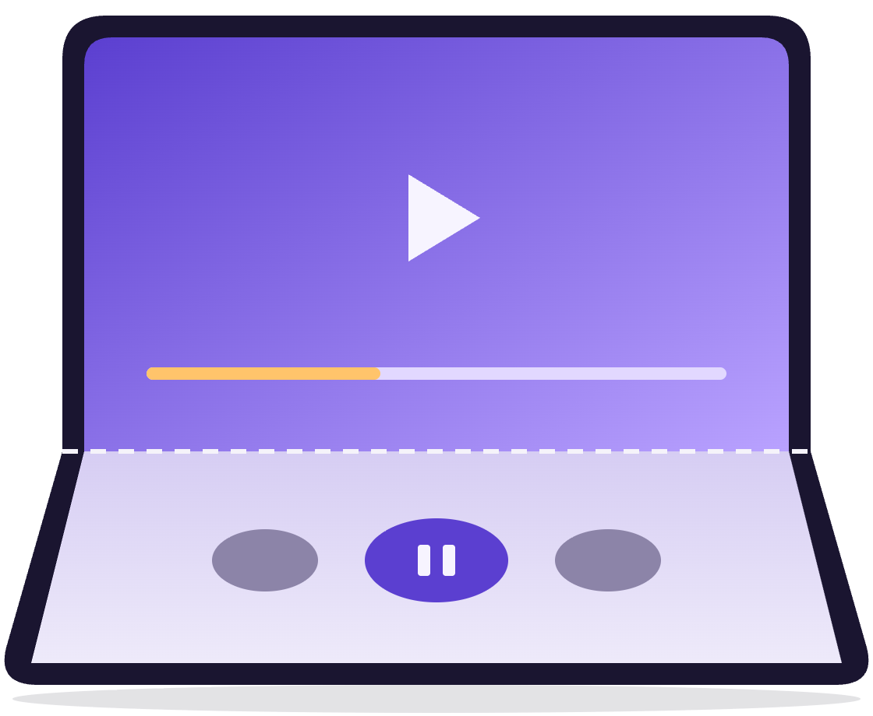
Tabletop: content up, controls down
Sample 03
<fold:TwoPaneView PanePriority="Pane2"
MinWideModeWidth="700"
MinTallModeHeight="100000"
TallModeConfiguration="BottomTop">
<fold:TwoPaneView.Pane1>
<local:PlayerControls />
</fold:TwoPaneView.Pane1>
<fold:TwoPaneView.Pane2>
<local:VideoView />
</fold:TwoPaneView.Pane2>
</fold:TwoPaneView>
Pane 2 above the fold, Pane 1 below it
A huge MinTallModeHeight stops a tall phone from stacking the panes. A dividing horizontal fold still does, and BottomTop puts Pane1 under it, near the thumbs.
Notes:
13:45 to 14:45. DEMO: tabletop on the Duo simulator, then the Showcase and the Inbox, which use the same size and order settings. The trick is two properties. MinTallModeHeight set far above any screen height means a regular tall phone never stacks the panes; it shows one, here the video, because PanePriority is Pane2. But a horizontal fold that divides the view still stacks them: that is tabletop. And TallModeConfiguration BottomTop flips the order so Pane1, the controls, goes below the fold, within reach, and Pane2, the video, sits above it at eye level. No posture code at all. The same pattern works for a camera viewfinder, a video call, or a recipe with the timer below.

Slide 16

Place things around the fold
Sample 04
protected override void OnPropertyChanged(
AvaloniaPropertyChangedEventArgs change)
{
base.OnPropertyChanged(change);
if (change.Property != Fold.StateProperty) return;
if (Fold.GetState(this) is { IsTabletop: true, FoldBounds: { } fold }
&& TopLevel.GetTopLevel(this) is { } top
&& top.TransformToVisual(this) is { } toLocal)
{
// FoldBounds is in top-level coordinates: map it first
var local = fold.TransformToAABB(toLocal);
Dialog.MaxHeight = local.Top - 16; // stay above the crease
}
}
In tabletop the dialog stays in the top half, clear of the fold
Notes:
14:45 to 15:30. When TwoPaneView isn’t the right tool, read the fold yourself. Watch Fold.StateProperty in OnPropertyChanged on any control. FoldState has two shortcuts, IsBook and IsTabletop. The one thing to remember: FoldBounds is in the top level’s coordinates, not your control’s, so map it with TransformToVisual before positioning anything against it. Avalonia 12 also pads content for safe areas, like the Duo’s sensor edge, which is another reason to map rather than use raw numbers. Here, a dialog in tabletop gets a maximum height that ends 16 pixels above the crease. The same approach places a floating toolbar, a tooltip or a camera shutter button.

Slide 17

The hinge as an input
Sample 05
protected override void OnPropertyChanged(
AvaloniaPropertyChangedEventArgs change)
{
base.OnPropertyChanged(change);
if (change.Property == Fold.HingeAngleProperty
&& change.OldValue is double oldAngle
&& change.NewValue is double newAngle)
{
// Folding drives the stars, the way scrolling does
DriveStars((newAngle - oldAngle) * HingeWarp);
}
}
0° closed
180° flat
110°
At most one update per frame. Effects only: many Android foldables report no angle.
Notes:
15:30 to 16:15. The hinge angle is the fun one. Fold.HingeAngle is in degrees, 0 closed and 180 flat, or null when the platform doesn’t report it. The iPhone Duo reports it through UIHingeInteraction. On Android, WindowManager has no angle, so the library reads the hinge angle sensor on Android 11 and later, when the device exposes one, and pauses it in the background. While the device folds, the angle can change several times a frame, so angle-only changes reach the tree at most once a frame. This code is straight from the Showcase: the change in angle drives the speed of the star field, the same way scrolling does. Delightful, and safe, because if the angle never arrives nothing breaks. Never use it for layout.

Slide 18
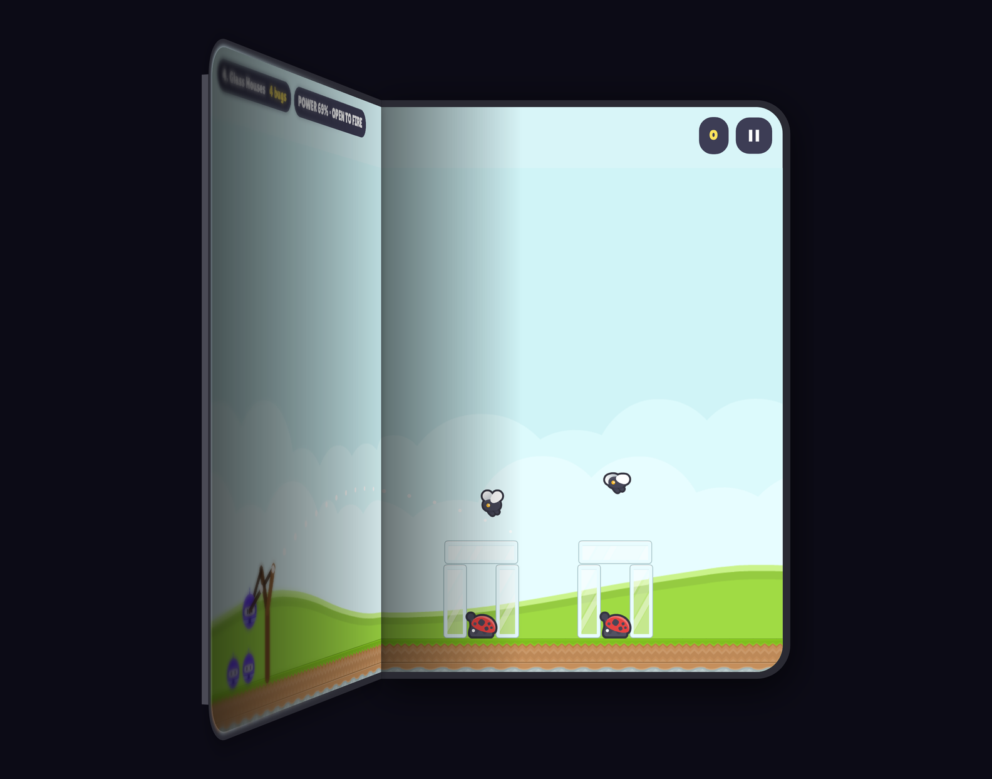

Bot vs Bugs, the hinge as a slingshot
Sample 06
Fold the phone to pull the sling, open it to fire
The deeper the fold, the stronger the shot, from Fold.HingeAngle
Flat or book: one level across both halves
Tabletop: the game above, a control deck below
Closed: it keeps playing on the cover display
Physics by Aether.Physics2D, art by Kenney, the bot from the .NET brand
Notes:
16:15 to 17:00. DEMO: Bot vs Bugs on the Duo simulator, or in the desktop simulator. This is the hinge as an input, taken all the way. While a bot waits on the sling, folding the phone pulls it back and snapping it open fires it: the deeper the fold, the stronger the shot. It is the same Fold.HingeAngle as the last slide, plus one check: the fold only counts if it started while the bot was ready, so opening the phone from closed never fires. Flat or in book posture the level spans both halves; in tabletop the bottom half becomes a control deck with a hinge gauge and an aim dial. Dragging the bot still works everywhere, because many Android foldables report no angle.

Slide 19
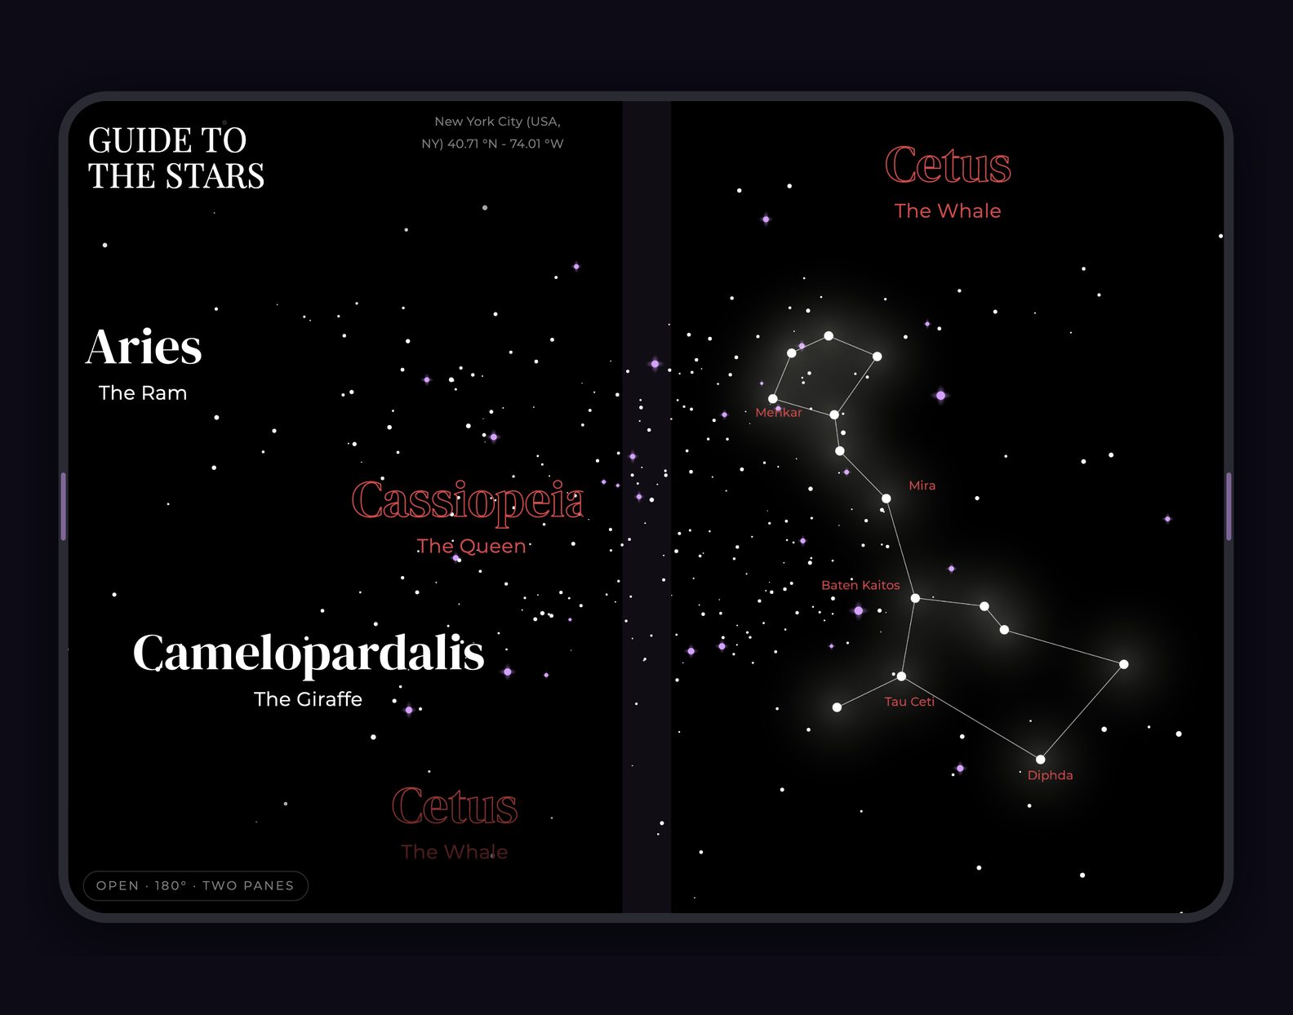
Guide To the Stars, on iPhone Duo
Sample 07
List and detail on either side of the fold, under one sky
The title card flies across the fold when you pick a constellation
A stacked layout in tabletop posture
State kept when the device folds and unfolds
The hinge warps the stars, the way scrolling does
The “Guide To the Stars” vignette from Avalonia Vignettes, adapted to two screens
Notes:
17:00 to 19:00. DEMO, the big one. If the live demo fails, stay on this slide’s screenshot and narrate the same flow. This is the Guide To the Stars vignette from my Avalonia Vignettes repo, adapted to two screens. Start closed on the cover display: one pane, the constellation list. Open the device: the list stays on the left and the selected constellation appears on the right, both under one continuous star field that carries across the fold. Tap a constellation: the title card flies across the fold to the detail page. Stand it in tabletop: the chart goes above, the list below. Fold and unfold: the selected constellation is still there. Move the hinge slowly: the stars warp. Everything you saw in samples 2, 3 and 5 is in this app.

Slide 20
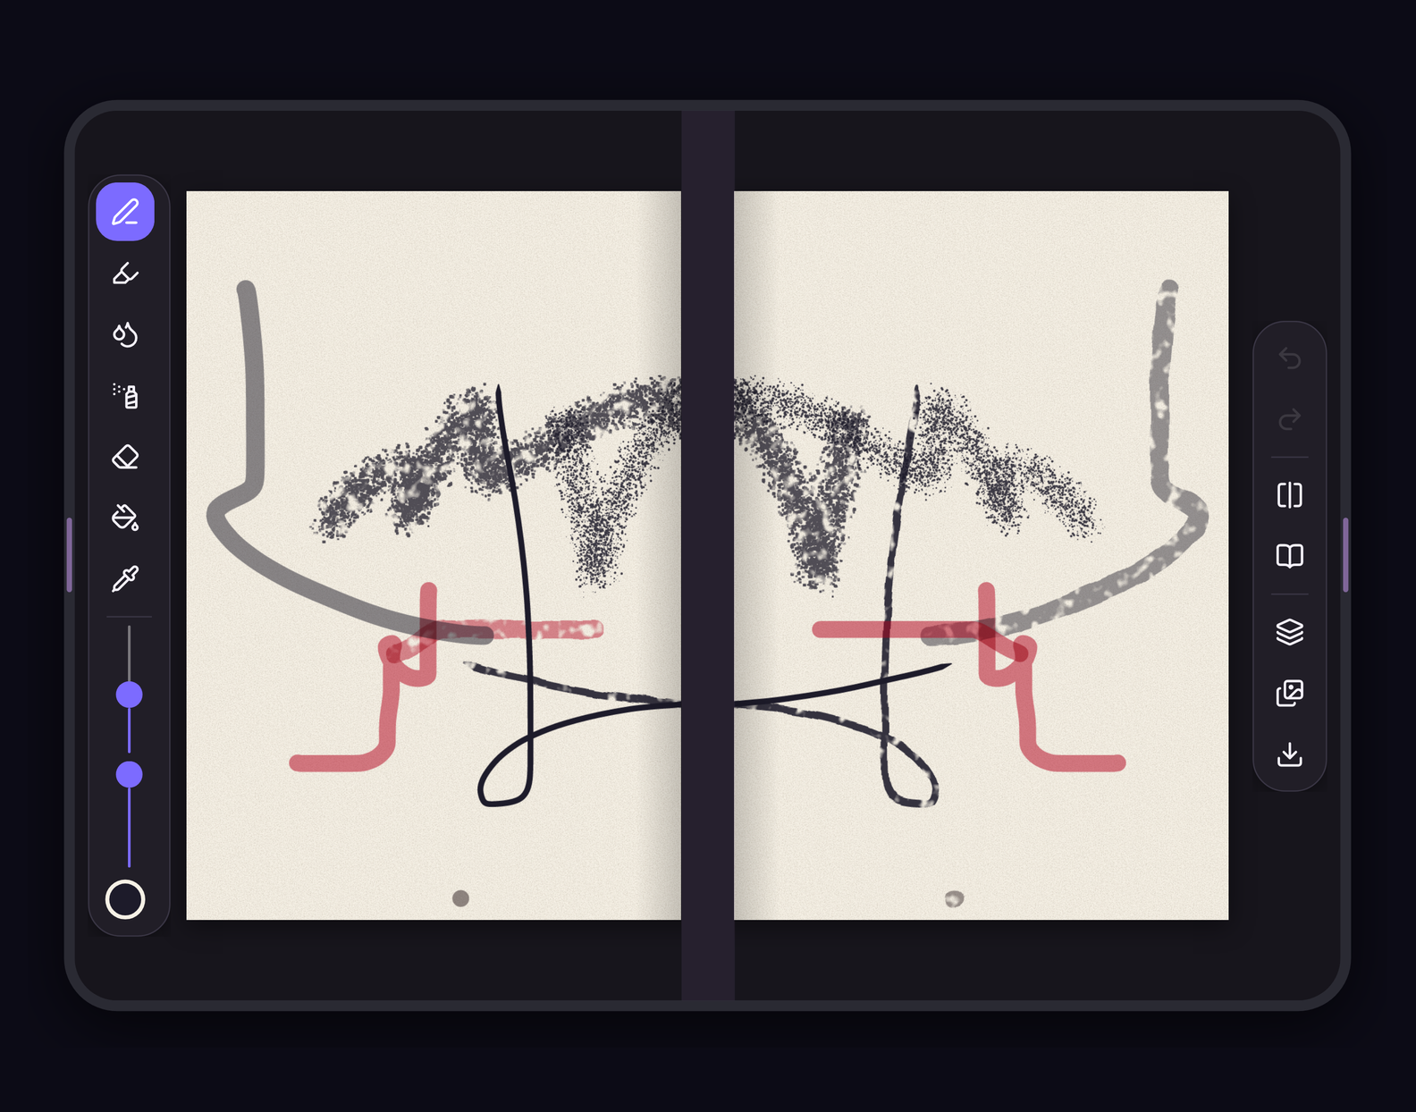
Inkfold, a sketchbook that folds
Sample 08
The page opens across the fold like a book
Arm the press, close the phone and open it: the paint prints on the facing page
Tabletop: page above, brushes and layers below
Pen, marker, watercolor and spray, in SkiaSharp
Layers, undo, symmetry, zoom and a gallery
The apps and these slides: jsuarezruiz/dotnetconf2026-avalonia-foldables
Notes:
19:00 to 19:45. DEMO: Inkfold. A paint app where the fold is the feature. The page opens across the fold like a sketchbook, its middle on the crease, with the tools on the left page and the actions on the right. Paint on one half, arm the press, then close the phone and open it: the paint prints onto the facing page, mirrored along the fold. In tabletop the page stands up like an easel and the brushes, colors and layers lie below it. The painting is SkiaSharp, the engine Avalonia already draws with. All three apps, and these slides, are in the session repo on the last slide.

Slide 21
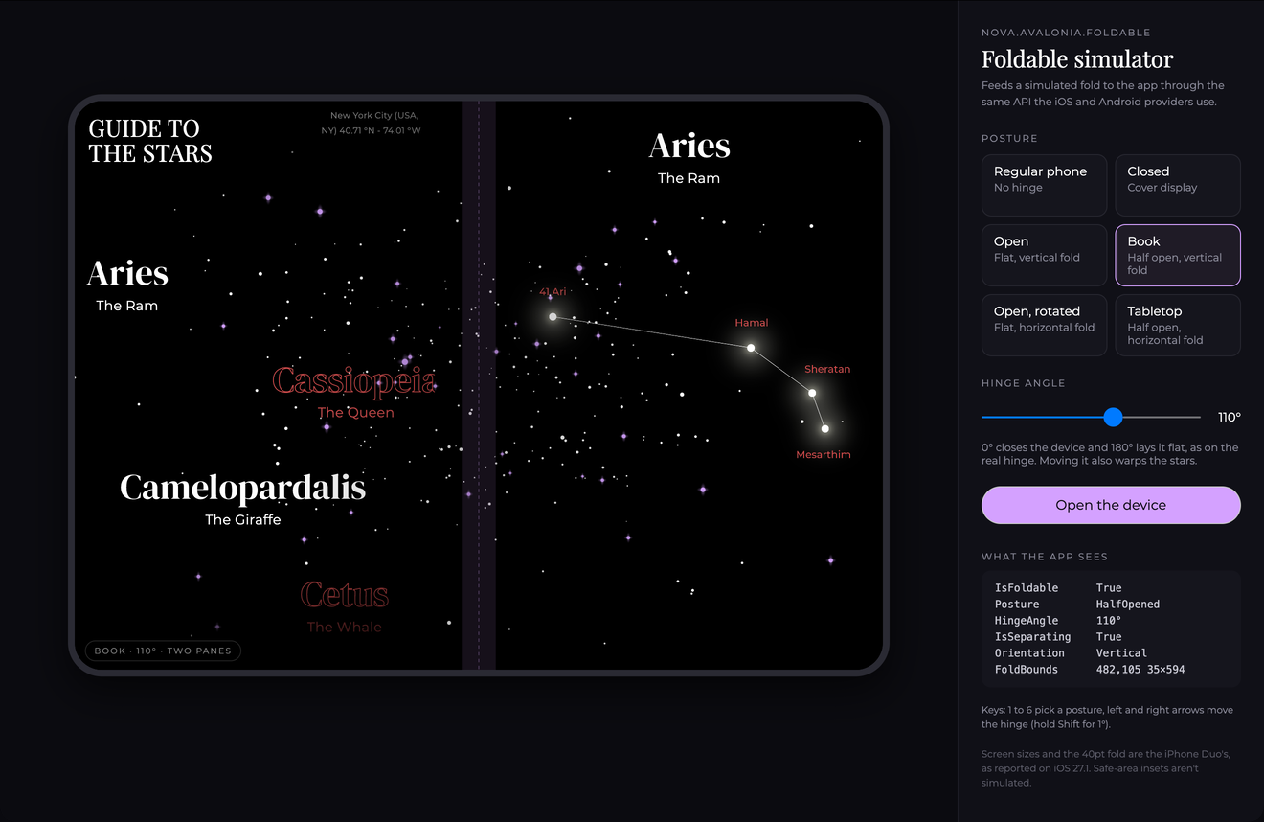
No foldable? Simulate one
Sample 09
var fold = new SimulatedFoldStateProvider();
Fold.SetProvider(window, fold);
fold.Current = new FoldState(
IsFoldable: true,
Posture: DevicePosture.HalfOpened,
HingeAngle: 110,
FoldBounds: new Rect(380, 0, 40, 860),
IsSeparating: true);
Same API as the real providers. Keys 1 to 6 pick a posture, the arrows move the hinge.
Notes:
19:45 to 21:00. DEMO: dotnet run --project samples/Nova.Avalonia.Foldable.Showcase/Nova.Avalonia.Foldable.Showcase.Desktop. You don’t need a foldable to build for one. SimulatedFoldStateProvider feeds a fold you set from code into the same attached properties the platform providers use, so your layouts can’t tell the difference. The Showcase desktop app wraps it in a simulator panel: regular phone, closed, open, book, open rotated and tabletop, with the iPhone Duo’s screen sizes and 40-point fold. The hinge slider works like the real hinge: 0 closes, 180 lays it flat. Keys 1 to 6 pick a posture, left and right arrows move the hinge, Shift for 1 degree, and Open the device plays the unfold animation. You can also set Fold.ProviderFactory so every window starts in a simulated posture while you design. Safe-area insets aren’t simulated, so do a final check on the real simulators.

Slide 22
Unit-test fold layouts, headless
Sample 10
[AvaloniaFact]
public void Half_Open_Splits_At_The_Fold()
{
var view = new TwoPaneView { Pane1 = new Border(), Pane2 = new Border() };
var window = new Window { Width = 900, Height = 600, Content = view };
Fold.SetProvider(window, new SimulatedFoldStateProvider(
new FoldState(true, DevicePosture.HalfOpened, 110, new Rect(430, 0, 40, 600), true)));
window.Show();
view.UpdateLayout();
Assert.Equal(TwoPaneViewMode.Wide, view.Mode);
Assert.Equal(new Rect(0, 0, 430, 600), view.Pane1!.Bounds);
Assert.Equal(new Rect(470, 0, 430, 600), view.Pane2!.Bounds);
}
Avalonia.Headless.XUnit with a simulated provider. The library’s own tests work this way.
Notes:
21:00 to 21:40. The same simulated provider makes fold layouts unit-testable with Avalonia’s headless platform. Create the view in a window, give the window a simulated half-open state with a 40-pixel fold at x 430, show it, run layout, and assert the result: wide mode, Pane1 ends exactly where the fold begins, Pane2 starts exactly where it ends. No device, no emulator, runs in CI in milliseconds. It’s adapted from the library’s testing docs, and the library’s own tests check the same layouts. Write one of these for every layout rule you care about, especially the tabletop and single-pane cases.

Slide 23
Then check on the real simulators
Sample 11
iPhone Duo simulator
Pixel Fold emulator, API 34
1
Install Xcode 27.1 with the iOS 27.1 runtime
# The image has no fold: give it one
adb shell settings put global \
display_features "fold-[1104,0,1104,1840]"
# 1 closed · 2 half open · 3 open
adb emu posture 2
# Move the hinge
adb emu sensor set hinge-angle0 110
# Read the Sample’s output
adb logcat -s DOTNET
2
Build the iOS head against the 27.1 SDK
3
Change postures with the buttons in Device Hub
Notes:
21:40 to 22:20. The simulator gets you 90% of the way; finish on the real thing. iPhone Duo: install Xcode 27.1 with the iOS 27.1 runtime (the 27.2 beta 1 runtime lists the Duo as unsupported), build against the 27.1 SDK or the app runs inset, and change postures with the buttons at the bottom of Device Hub, which replaces the Simulator app in Xcode 27. Android: the Pixel Fold profile on the Android 14, API 34 image, with the GPU enabled. The image defines no fold, so set display_features once. Then adb emu posture folds it, the hinge-angle sensor moves the hinge, and logcat shows the Sample’s output. Avoid the 7.6 inch Foldable profile: it reports postures shifted by one. Debug APKs installed with adb need EmbedAssembliesIntoApk.

Slide 24
A fold is a resize, not a relaunch.
Part 4 of 4 · Tips
The user was reading, typing and scrolling.
After the fold, they still should be.
Notes:
22:20 to 22:40. If you remember one sentence from this talk, make it this one. Folding is not a new session. The person was halfway through an email, scrolled to the middle of a list, with the cursor in a text field. After the fold, all of that must still be true. Four slides on how.

Slide 25
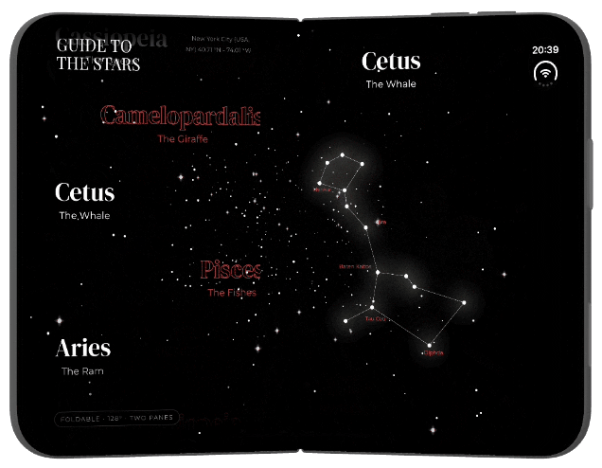
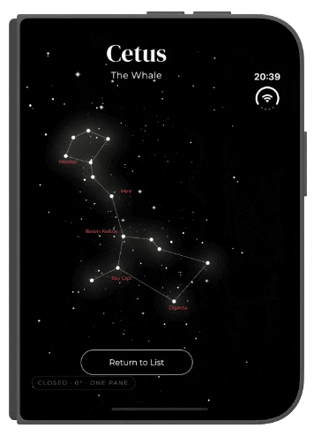

Keep the app alive through the fold
Tips
1
On Android, handle configuration changes, or every fold recreates the activity.
2
Hide panes, don’t remove them. TwoPaneView keeps the hidden pane alive, state and all.
3
Keep state in view models: selection, drafts, navigation.
4
Never cache screen sizes. Read Bounds when you lay out.
Open, Cetus selected
Closed, still Cetus
Notes:
22:40 to 23:50. Continuity starts at the platform level. On Android, if the activity doesn’t declare that it handles orientation, screen size, screen layout, smallest screen size, density and UI mode changes, every fold destroys and recreates it, and your whole Avalonia view with it. That’s the line from the setup slide. Inside the app, the second rule: don’t swap views per layout. TwoPaneView only hides the pane it isn’t showing, the way WinUI collapses it, so the pane keeps its visual tree, its scroll offset, its text boxes, and comes back exactly as it was when the device unfolds. Third, anything the user would be upset to lose goes in the view model: the selected item, a draft, the navigation stack. Fourth, never cache a screen size: on the Duo, Split View and folding both change your window size at any moment. The pictures are from the Showcase: Cetus is selected with the device open, and when it closes, the cover display still shows Cetus, because the selection is remembered even with two panes on screen.

Slide 26
Keep the scroll position
Tips
Reader.ScrollChanged += (_, e) =>
{
// Real scrolling only, not a resize
if (e.ViewportDelta == default && e.ExtentDelta == default)
_vm.ReadingPosition = CharacterAtTop();
};
// After the fold, bring the same words back to the top
Body.SizeChanged += (_, e) =>
{
if (e.WidthChanged && _vm.ReadingPosition > 0)
Dispatcher.UIThread.Post(
() => ScrollToCharacter(_vm.ReadingPosition));
};
Anchor to the words
The width changes, every line rewraps, and the same pixel offset lands in another paragraph.
Lists keep their place
A virtualizing ListBox keeps its first row through a resize.
Notes:
23:50 to 25:00. DEMO: in the Inbox, scroll the long message halfway, then stand the phone up in tabletop. Scroll position is the first thing users notice when it breaks. TwoPaneView keeps the hidden pane’s ScrollViewer alive, so the offset survives. But an offset is a number of pixels, and when the message goes from one page, 455 points wide, to the full 951 in tabletop, every line rewraps and the text gets much shorter: the same offset now shows another paragraph, or nothing at all. So remember what the user was reading, not where. Listen to ScrollChanged, ignore events caused by viewport or extent changes, those are the resize itself, and record the character at the top of the view; TextLayout.HitTestPoint gives it to you. When the text’s width changes, post a scroll that brings that character back to the top; HitTestTextPosition says where its line is now. The position lives in the view model, so it would survive the view being rebuilt. Lists are the easy case: a virtualizing ListBox keeps its first visible row through a resize on its own, because the rows above it aren’t measured again.

Slide 27
Keep the focus where the user is
Tips
AddHandler(GotFocusEvent, (_, e) => _focused = e.Source as Control);
Panes.ModeChanged += (_, _) =>
{
if (_restore is { IsEffectivelyVisible: true } back)
{
_restore = null;
back.Focus(); // its pane is back
}
else if (_focused is { IsEffectivelyVisible: false } hidden)
{
_restore = hidden; // its pane just hid
CounterpartOf(hidden).Focus(); // land next door
}
_focused?.BringIntoView();
};
Never focus the invisible
Move focus next door when a pane hides, and bring it back when the pane returns.
Text survives
Hidden panes keep their text and caret, and their selection with ClearSelectionOnLostFocus off.
Notes:
25:00 to 26:10. DEMO: in the Inbox, select a word in a reply, close the phone and open it again. Focus is the one everybody forgets, and keyboard and screen reader users pay for it. Foldables get used with keyboards too, especially in laptop and tabletop poses. When the device closes and TwoPaneView goes to one pane, the focused control might live in the pane that just hid. Avalonia drops the focus when its pane hides, so the next Tab press starts from nowhere in particular. The pattern: track the focused control with a GotFocus handler. On ModeChanged, if it is no longer effectively visible, remember it and move focus to its counterpart in the visible pane; CounterpartOf is your own mapping, for example the reply box maps to the selected message in the list. When the device opens again and that control is visible, give focus back. Either way, BringIntoView so the focused control is on screen after the layout change. And because the pane is only hidden, a half-written reply keeps its text and caret. A TextBox clears its selection when it loses the focus, unless you set ClearSelectionOnLostFocus to False, as the Inbox does.

Slide 28
Twelve rules to take home
Tips
Space, not device
Clear the crease
Even columns
Ease, don’t jump
Let the width pick the layout. Never isTablet.
No buttons, fields or faces on the fold.
Two or four columns split cleanly at the fold.
Folding should feel like more room, not a new app.
Angles for effects
Map, then measure
Pause hidden panes
Pick the one pane
Lay out by posture and bounds, never the angle.
FoldBounds is top-level. Safe areas pad content.
Their timers keep running. Check IsEffectivelyVisible.
PanePriority decides what the cover display shows.
Back, when alone
Scale, don’t clip
Mind Split View
Test both ways
Show a back button only in single-pane mode.
A LayoutTransformControl fits narrow panes.
On the Duo, your window is not the screen.
Simulated folds in CI, then the real simulators.
Notes:
26:10 to 28:00. Twelve rules to take home; the first row is design, straight from Apple’s guidelines for the Duo and just as true on Android. One: let the available width pick the layout, never device type or orientation. Two: keep the crease clear of buttons, text fields and faces. Three: prefer an even number of columns, Apple’s own wording, because an odd column lands on the fold. Four: avoid extreme layout changes as people fold; a short cross-fade beats a hard jump. Second row, layout mechanics. Five: the hinge angle is for delight, not layout, because many Android devices don’t expose a hinge sensor. Six: FoldBounds is in top-level coordinates and Avalonia 12 pads for safe areas like the Duo’s sensor edge, so map before you measure. Seven: the hidden pane keeps running, so pause expensive animations and timers when it isn’t effectively visible. Eight: PanePriority decides what the cover display shows; follow the user’s current task. Last row, polish and process. Nine: a back button only makes sense in single-pane mode; toggle it from ModeChanged. Ten: when a pane is narrower than your design, the Showcase wraps the list in a LayoutTransformControl and scales it instead of clipping. Eleven: Split View comes to the iPhone on the Duo, so your window can be half the inner display. Twelve: simulated folds in CI, then the real simulators before you ship.

Slide 29
Thank you
Now go unfold your UI.
The slides and demos
jsuarezruiz/dotnetconf2026-avalonia-foldables
The library
github.com/jsuarezruiz/Nova.Avalonia.Foldable
The docs
jsuarezruiz.github.io/Nova.Avalonia.Foldable
Guide To the Stars and friends
github.com/jsuarezruiz/avalonia_vignettes
Reports from real devices welcome
#dotnetconf
Javier Suárez · Avalonia UI · @jsuarezruiz
Notes:
28:00 to 29:00. Wrap up in three sentences. Foldables are here, with the iPhone Duo in stores and Android requiring adaptive apps. The fold is just a rectangle: know where it is, keep things off it, and treat folding as a resize, not a relaunch. With Avalonia and Nova.Avalonia.Foldable you get that from one shared codebase on iOS, Android, desktop and the web. The library is MIT licensed and on GitHub; it isn’t on NuGet yet, and reports from real devices are the most useful contribution right now. Thank you. That leaves about a minute for questions.

